Slide 1
DEVICE FILES
Also called as Special File.
A device file allows to accesses hardware devices so that end users do not need to get technical details about hardware.
It is an interface for a device driver that appears in a file system as if were an ordinary file.
Allows software to interact with the device driver using I/O system calls, which simplifies many tasks.

Slide 2
Types of device files
Types of device files
Block device
Designed to operate in terms of block.
Has an associated block device driver that performs I/O by using file system block-sized buffers from a buffer cache supplied by kernel.
Ex: Hard disks, USB cameras, Disk-On-Key.
Character device
Designed to operate on a stream of characters, read from or written to it.
Has a character device driver associated with it, that can be used for a device like line printer that handles one character at a time.
Ex: Serial ports, parallel ports, sounds cards.

Slide 3
Block vs Character devices
Block device | Character device
Accessed by block-by-block. | Accessed in sequential order i.e., character-by-character.
Addressable in device specified blocks. | Not addressable.
Seeking is possible. | Seeking is not allowed.
Accessed through cache, so buffering is required. | No buffering.
More complex. | Less complex.
Hard drive, Pen drives. | Keyboard, Serial port.

Slide 4
Interrupt ReQuests (IRQ)
A hardware signal sent to the processor that temporarily stops a running program and allows a special program to run instead.
Auto-detecting IRQ number
Probing
Way for driver to determine which IRQ line to be used by device.
Driver tells device to generate interrupts.
Only one line should be activated.
probe_irq_on(void);
probe_irq_off(unsigned long);
These functions are used by the driver when it has to probe to determine what interrupt line is being used by a device. The result of probe_irq_on must be passed back to probe_irq_off after the interrupt has been generated. The return value of probe_irq_off is the detected interrupt number.

Slide 5
Interrupt Handler
A callback function in an operating system, or a device driver whose execution is triggered by the reception of an interrupt.
Initializing the IRQ interface
request_irq(unsigned int irq, void (*handler)(), unsigned long flags, const char *device, void *dev_id);
free_irq(unsigned int irq, void *dev_id);
These calls are used to register and unregister and interrupt handler.
Disabling Interrupts
When kernel doesn’t want to be interrupted
cli(void);
“Clear the Interrupts flag” – disable interrupts
sti(void);
“Set the Interrupts flag” – enable interrupts

Slide 6
Interrupt Handler split into two halves
“Top Half”
Scheduled immediately when an interrupt occurs.
Performs only the work that is time-critical, such as acknowledging receipt of the interrupt or resetting the hardware.
“Bottom Half”
Scheduled after the top half.
Executed at a safer time (because interrupts enabled).
mark_bh(int nr);
This function marks a bottom half for execution

Slide 7
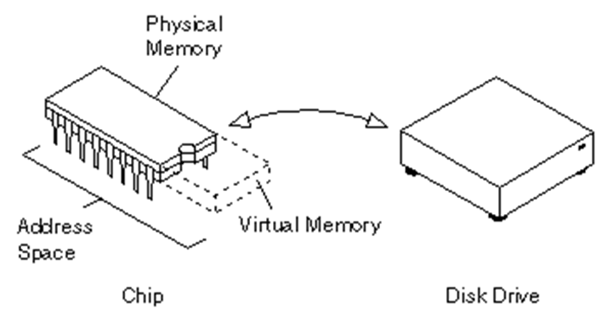
VIRTUAL MEMORY
Types of device files
The term ‘Virtual memory’ refers to something which appears to be present but actually it is not.
The virtual memory technique allows users to use more memory for a program than the real memory of a computer.

Slide 8
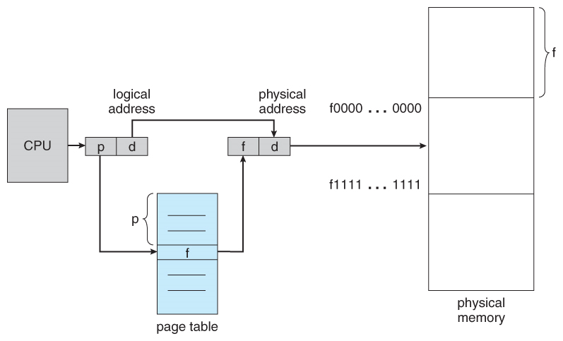
Page: Memory is divided into chunks of equal size called Page.
Page tables: The data structure used by a virtual memory system to store the mapping between virtual addresses and physical addresses.

Slide 9
Page Replacement Algorithms
Types of device files
Needed to decide which page needed to be replaced when new page comes in.
Whenever a new page is referred and not present in memory, page fault occurs and Operating System replaces one of the existing pages with newly needed page.
Types
LRU
Buddy

Slide 10
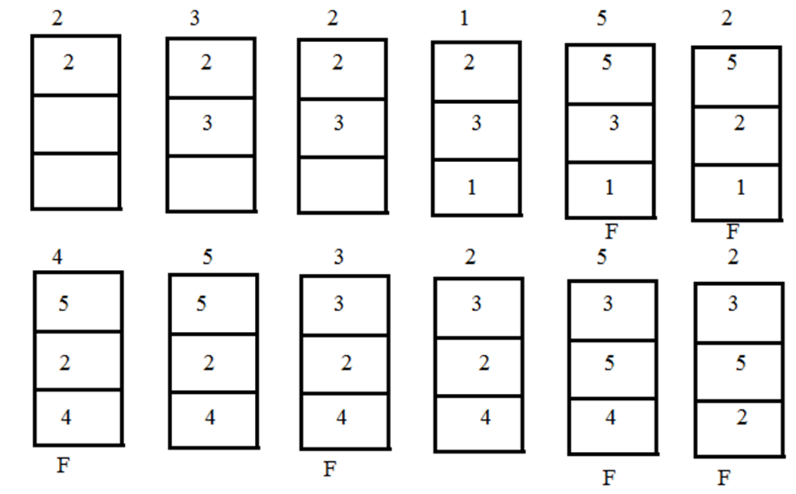
LRU
Types of device files
A least recently used page algorithm, keeps track of page usage over a short period of time.

Slide 11
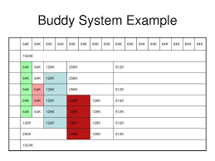
Buddy Algorithm
Types of device files
Invented in 1963 by Harry Markowitz.
A memory allocation algorithm that divides memory into partitions to try to satisfy a memory request as suitably as possible.

Slide 12
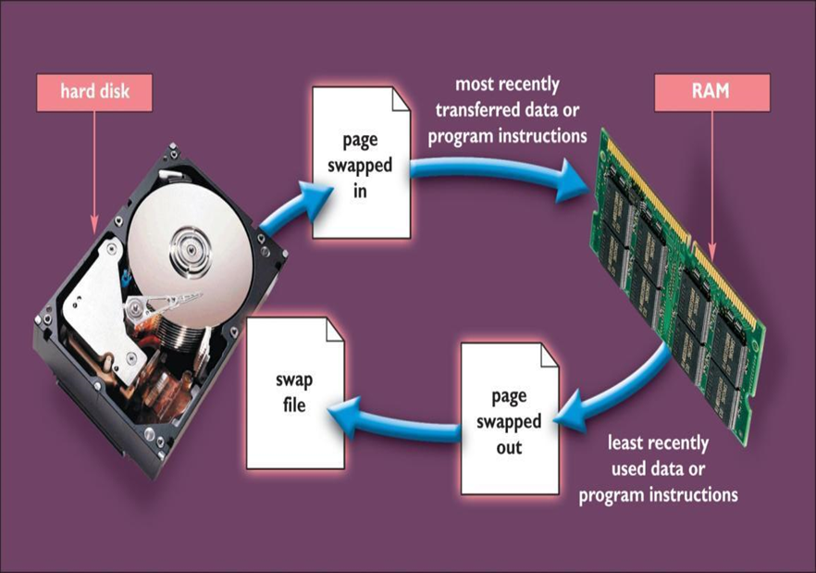
Memory Swapping
Interchanging the pages between physical memory and disk is called as Swapping.
The exact state or "page" of memory is copied to the disk to make the data contiguous and easy to restore later.

Slide 13
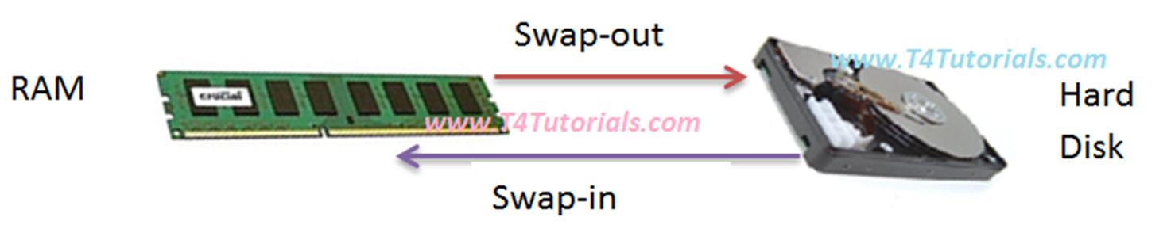
Swap-in
The process of writing pages out from physical memory to disk is called as Swap-in.
Swap-out
The process of loading pages from disk to physical memory is called as Swap-out.

